Slide 1
Dynamic Programming

Slide 2
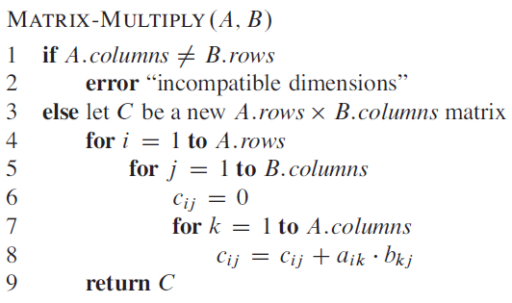
Dynamic programming - examples
Given chain of n matrices, we wish to find the product A₁*A₂* … *A_{n}.
We can multiply two matrices A₁ and A₂ if they are compatible,
i.e., the number of columns of A = the number of rows of B.
Matrix multiplication is associative - (A₁*A₂)*A₃ = A₁*(A₂*A₃)
If A is p*q matrix, B is q*r matrix, then C is p*r matrix.
The number of scalar multiplications = p*q*r.
T(n) ~ number of scalar multiplications.

Slide 3
Dynamic programming - examples
Example: we need to find the product of <A₁, A₂, A₃>
Assume A₁ is 10*100, A₂ is 100*5, and A₃ is 5*50
If we multiply ((A₁A₂)A₃), then
10*100*5 = 5000 multiplications for A₁*A₂ = A’ (A’ = 10*5 matrix)
10*5*50 = 2500 multiplications for A’*A₃
In total, 5000 + 2500 = 7500 multiplications
If we multiply (A₁(A₂A₃)), then
100*5*50 = 25000 multiplications
10*100*50 = 50000 multiplications
Total = 25000 + 50000 = 75000 multiplications
The first parenthesization is 10 times faster the second.

Slide 4
Dynamic programming - examples
The matrix-chain multiplication problem: given a chain of <A₁, A₂,…, A_{n}> of n matrices, where for i = 1,2, …, n, matrix A_{i} has dimension p_{i-1}*p_{i}, fully parenthesize the product A₁A₂…A_{n} in a way that minimizes the number of scalar multiplications.
<A₁,A₂,A₃,A₄> can be fully parenthesized in 5 distinct ways:
(A₁(A₂(A₃A₄)))
(A₁(A₂A₃)A₄))
((A₁A₂)(A₃A₄))
((A₁(A₂A₃))A₄)
(((A₁A₂)A₃)A₄)
What about for n matrices, how many distinct ways can we parenthesize
the product of n matrices?

Slide 5
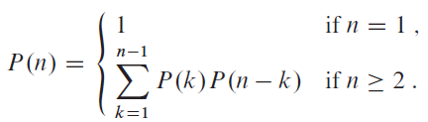
Dynamic programming - examples
P(n) – the number parenthesization of a sequence of n matrices.
P(n) = Ω(2^{n})

Slide 6
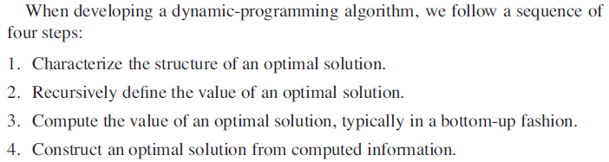
Dynamic programming - examples

Slide 7
Dynamic programming - examples
Step1: The structure of an optimal parenthesization
Let A_{i..j} denote the product of A_{i}A_{i+1} … A_{j}, i <= j
If i < j, (A_{i}..A_{k})(A_{k+1}..A_{j}), for some k s.t. i <= k < j
Optimal substructure of this problem:
Suppose optimal parenthesization of A_{i}..A_{j} splits into A_{i..k} and A_{k+1..j}
Then parenthesization of A_{i..k} is also optimal
Similarly A_{k+1}..j is also optimal

Slide 8

Dynamic programming - examples
Step2: Recursive solution
Let m[i,j] be the minimum number of scalar multiplications needed to compute A_{i..j}. So, to compute to compute A_{1..n} we need m[1,n] multiplications.
If A_{i} is p_{i-1}*p_{i} matrix, then m[i,j] can be defined recursively as follows:
Additional memory s[i,j] can be used to help keep track of how
to construct an optimal solution. It will store the value of k.

Slide 9
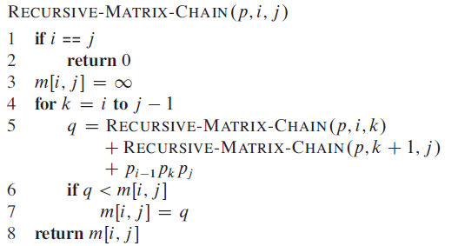


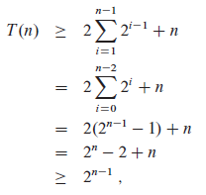
Dynamic programming - examples

Slide 10
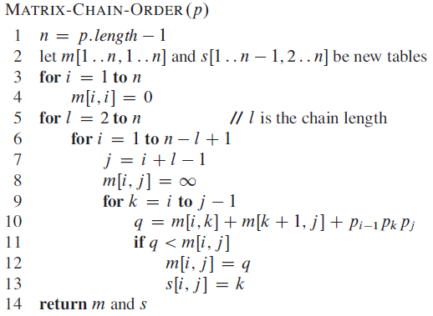
Dynamic programming - examples
Step 3: Computing the optimal costs

Slide 11
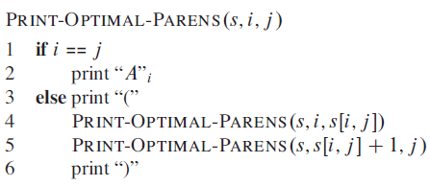
Dynamic programming - examples
Step 4: Constructing an optimal solution

Slide 12
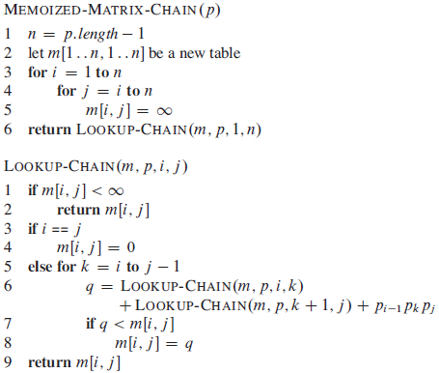
Dynamic programming - examples

Slide 13
Dynamic programming - examples
The longest-common-subsequence problem: we are given two sequences X = <x₁, x₂, …, x_{m}> and Y = <y₁,y₂, …, y_{n}>, and wish to find a maximum-length common subsequence of X and Y.
A subsequence of a given sequence is just the given sequence with zero or more elements left out.
X = ABCDEF, Y = BDE
Y is a subsequence of X
Brute force approach takes exponential time as there are 2^{n} subsequences.

Slide 14
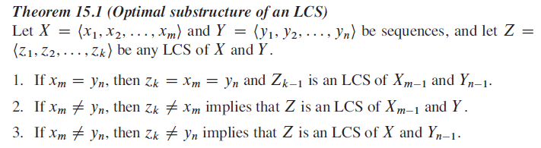
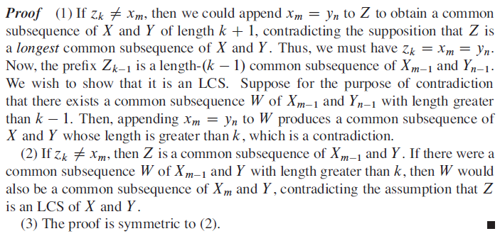
Dynamic programming - examples
Step 1- Characterizing a longest common subsequence
The LCS problem has an optimal-substructure property

Slide 15
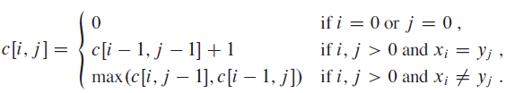
Dynamic programming - examples
Step 2- A recursive solution

Slide 16
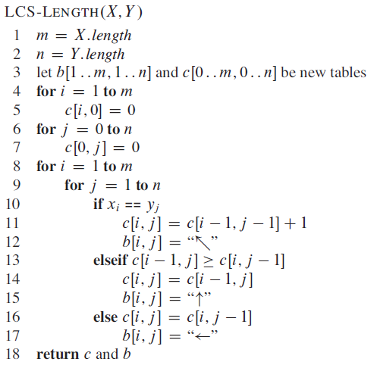
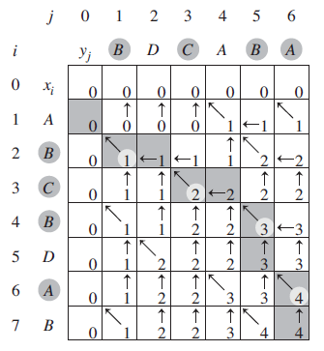
Dynamic programming - examples
Step 3- Computing the length of an LCS

Slide 17
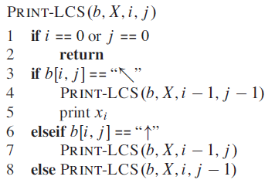
Dynamic programming - examples
Step 4 – Constructing an LCS

